Slide 1

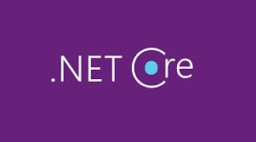
Introduction to .Net Core
Venkat shiva reddy
.Net Evangelist

Slide 2
Key Take Aways
Overview
Characteristics
Release History
Components
Languages
Application Types
IDE
Deployment Models
Execution Models

Slide 3
.Net Core Overview
NET Core now known as .NET is a free, open-source, cross-platform development platform created and maintained by Microsoft for building various types of applications for the users.
.NET Core platform is also being maintained by the .NET community on GitHub along with Microsoft.
Notes:
NET Core has been developed from scratch to make it a lightweight, cross-platform, modular and fast Framework. To reduce the memory footprint of applications in .NET Core by default the application contains only the core features to run the application and other features are optional/additional which you can add based on your requirements.
.NET Core was developed to overcome the limitation of the .NET framework of being able to run only on Windows. The .NET Core also supports more variety of applications targeting different platforms as compared to the .NET Framework.
When you develop applications with .NET Core then no matter which type of application you are building your code and project files will feel the same. The runtime, base API and language capabilities are also the same irrespective of the type of application being developed.
.NET Core is supported by Microsoft on Windows, macOS & Linux. Microsoft provides regular updates for security and quality. Microsft makes use of Self-maintained azure servers to test new releases of .NET Core

Slide 4
.NET Core Characteristics
Open Source – MIT & Apache 2 License
Cross-Plotform – Windows, Mac OS, Linux, Android, iOS, tvOS, watchOS
Flexible Deployment Models – Self Contained, Framework Dependent, Dockor
Consistence across Process Architecture – x64, x86, ARM32, ARM64
Modular Architecture – NuGet Packages
Compatibility - .Net Framework, Xamarin, Mono via .Net Standard
Fast, Lightweight and Friendly
Notes:
.NET Core was written from scratch mainly to provide the following characteristics to the developers
Open Source – The .NET Core Framework is open source using MIT & Apache 2 License. The .NET Core is a project of the .NET Foundation. Here is the complete list of .NET repositories on GitHub.
Cross-Platform – The .NET Core can be used to create applications for many platforms such as Windows, macOS, Linux, Android, iOS, tvOS and watchOS. The .NET Core also allows you to use platform-specific APIs of the operating system.
Flexible Deployment Models – .NET Core applications can be deployed as either self-contained apps that include both the .NET Core runtime and libraries or as framework-dependent apps that require the .NET runtime and libraries to be installed on the user machine. The .NET Core applications can also be installed using Docker containers.
Consistent across Processor Architectures – The .NET Core runs your applications with the same behaviour on multiple processor architectures including x64, x86, ARM32 and ARM64.
Modular Architecture – The .NET Core is divided into modular components known as NuGet packages. These NuGet packages are separated as per the functionality provided by them. You can only include the required NuGet packages as per your requirements and functionality provided by your application. Even the .NET Core library is provided as NuGet packages as this allows you to choose components instead of including the entire .NET Core Framework
Compatibility – As .NET Standard is the base library for .NET Implementations .NET Core is also compatible with .NET Framework, Xamarin and Mono via .NET Standard.

Slide 5
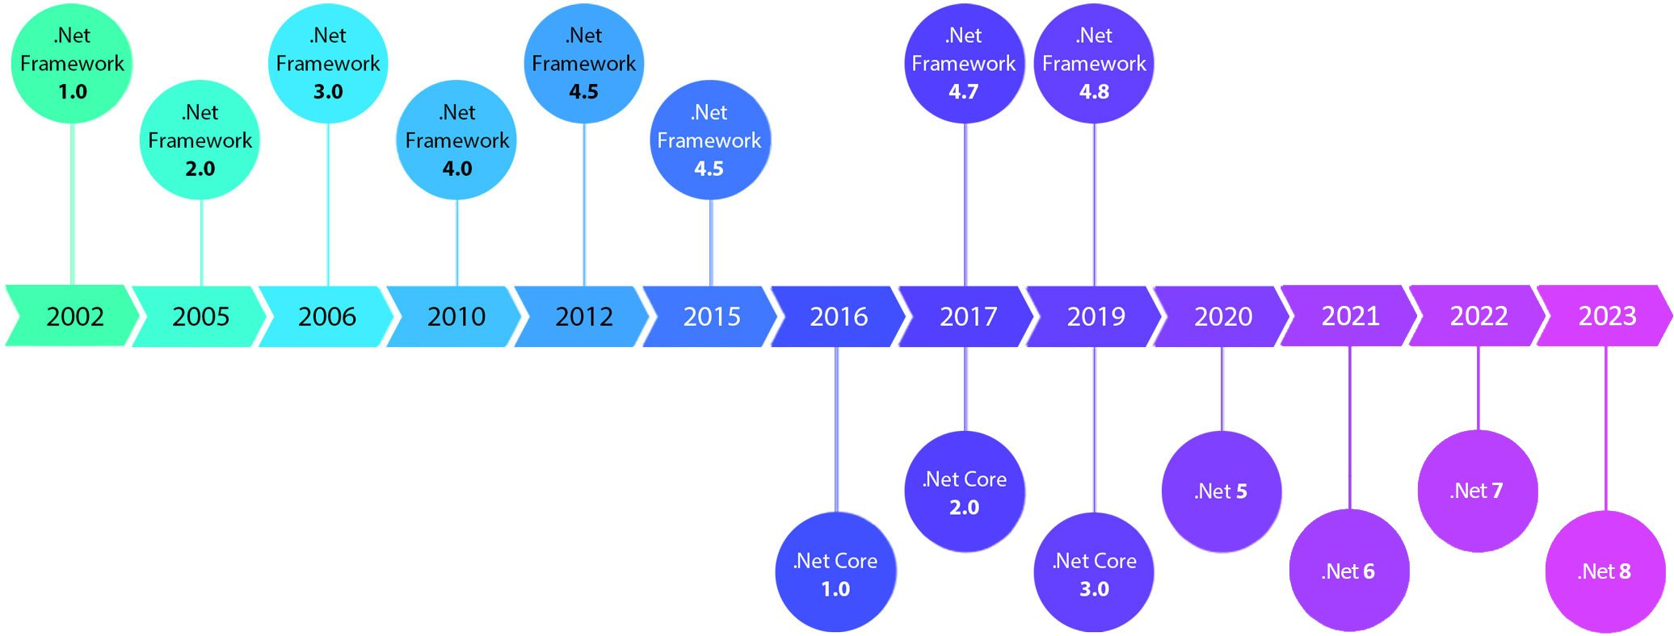
.Net Release History

Slide 6
.Net Core Components
.Net SDK
.Net CLI
The dotnet driver
Roslyn
MSBuild
.Net Runtime (CLR & JIT)
Runtime Libraries
Notes:
.NET Core provides SDK & runtimes to be downloaded & installed to run .NET Core based applications. The .NET Core SDK is more for the developers that contain libraries & tools for developing and running .NET Core applications. The .NET Core runtime is just the execution environment for running .NET Core based applications.
The .NET Core SDK consists of the following components
The .NET CLI is the command-line interface tool for the development, testing, & deployment of .NET Core based applications.
The dotnet driver is the CLI command (dotnet.exe) that is responsible for executing commands that are provided to it and running framework-dependent applications. You can pass commands to the dotnet driver as shown below
dotnet build
dotnet new console
dotnet –help
Roslyn is the programming language compiler
The MSBuild is the build engine used to build .NET Core based applications
The .NET runtime (CLR & JIT) provides the execution environment services to .NET Core based applications.
The Runtime Libraries provides the type system and a vast set of APIs and types for the development and implementation of the common functionality in your application

Slide 7
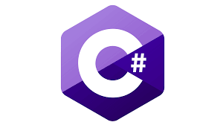


.Net Core : Languages
.NET Core applications are written in C#, F#, or Visual Basic.Net and compiled to Common Intermediate Language (CIL).

Slide 8
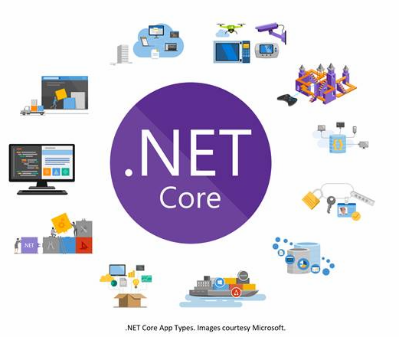
.Net Core: Application Types
Web Applications
Web API and Microservices
Serverless Functions for Cloud
Cloud Native Applications
Mobile Applications
Desktop Applications – Console Applications, Windows WPF & Windows Forms
Gaming Applications
Internet of Things (IoT) Applications
Machine Learning
Windows Services
Class Library

Slide 9
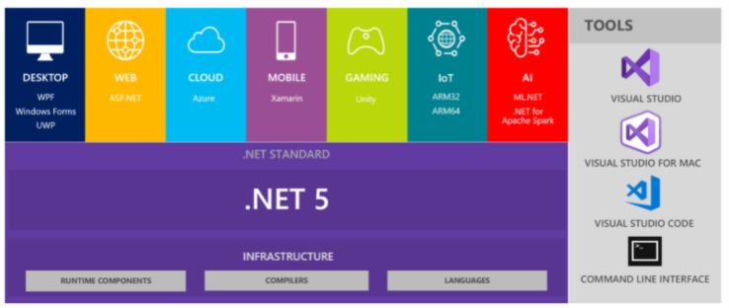
.Net: An Unified Platform

Slide 10
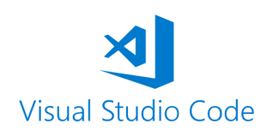
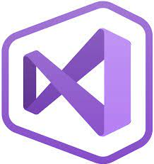
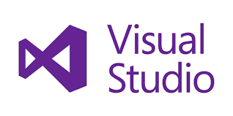
.Net Core IDE
Visual Studio for Mac
Notes:
.NET Core also provides options for the integrated development environment (IDE) that can be used by developers and IDE for .NET Core includes the following options
Visual Studio IDE (integrated development environment) can be used for the development of applications using the .NET Core. This is a windows only IDE and provides extensive functionality for development, executing and testing your applications. There are different editions of Visual Studio provided by Microsoft and there is also a community edition that is free for students, open-source contributors, and individuals.
Visual Studio Code is a code editor provided by Microsoft that can run on Windows, macOS & Linux. There are extensions available for Visual Studio Code for working with .NET Core applications.
Visual Studio for Mac IDE can be used on macOS only. This can be used to develop .NET Core apps and games for iOS, Android & Web.

Slide 11
.Net Core Deployment Models
NET Core provides 2 different models for publishing .NET Core applications
Self-Contained
Framework Dependent
Notes:
Self-Contained – In this model, .NET Core application binaries and all of its dependencies including third-party libraries, .NET Core runtime and libraries get deployed along with it. So there is no need for users to install any other runtime of software just install the self-contained .NET Core app to use the application on that machine. Self-contained .NET Core applications are platform-specific.
Framework-Dependent – In this model just .NET Core application binaries get deployed along with the application and to execute this application users need to separately install the third-party dependencies if any, .NET runtime and libraries. In this model the executables are platform-specific but the assemblies .dll files are cross-platform. Users can install multiple versions of .NET Core runtime side by side to run .NET Core applications targeting different versions of the runtime.

Slide 12
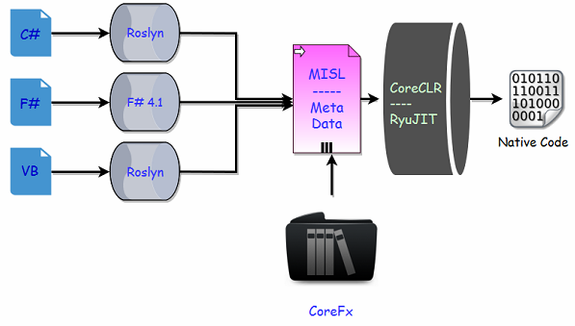
.Net Core Execution Model
Notes:
n .NET Core now we have a new series of compilers, like we have Roslyn for C# and VB.
You can also make use of the new F# 4.1 compiler if you want to use F# with .NET Core.
Actually these tools are different and we can use Roslyn with .NET Framework as well if we are using C# 6 or later, because C# compiler can only support up to C# 5.
In .NET Core, we don’t have a framework class libraries (FCL), so a different set of libraries are used and we now have CoreFx.
CoreFx is the reimplementation of the class libraries for .NET Core.
We also have a new run time with .NET Core known as CoreCLR and leverages a JIT Compiler.
Now the question is why do we have the reimplementation of all these components that we already have in .NET framework.
So the answer is the same as why Microsoft implemented .NET Core.

Slide 13
Roslyn: .Net Core Language Compiler
A new .NET Compiler Plotform which is based on compiler “As-a-Service”
An open-source C# and VB.Net compiler with rich code analysis APIs
Enables building code anasysis tools with the same APIs that are used by Visual Studio IDE

Slide 14
Core CLR: .Net Runtime
Runtime implementation of .NET Core
Collection of Technologies and Components like RyuJIT, Garbage Collector, Native Interop, etc
Cross-Plotform

Slide 15
RyuJIT: Just-In-Time Compiler
Next generation Just-In-Time (JIT) compiler for .NET Core
Supports High-performance JIT architecture, focused on high throughput, JIT compilation
The new JIT is twice as fast
Apps compiled with RyuJIT start up to 30 percent faster

Slide 16
.NET CLI: Command Line Interface
A toolchain for building, developing and publishing .NET Core based applications
Supports Installation of NuGet Packages
Cross-plotform support
Support various commands
Dotnet new, dotnet restore, dotnet run, dotnet build, etc

Slide 17

.Net Core: Summary
Overview
Characteristics
Release History
Components
Languages
Application Types
IDE
Deployment Models
Execution Models

